Slide 1
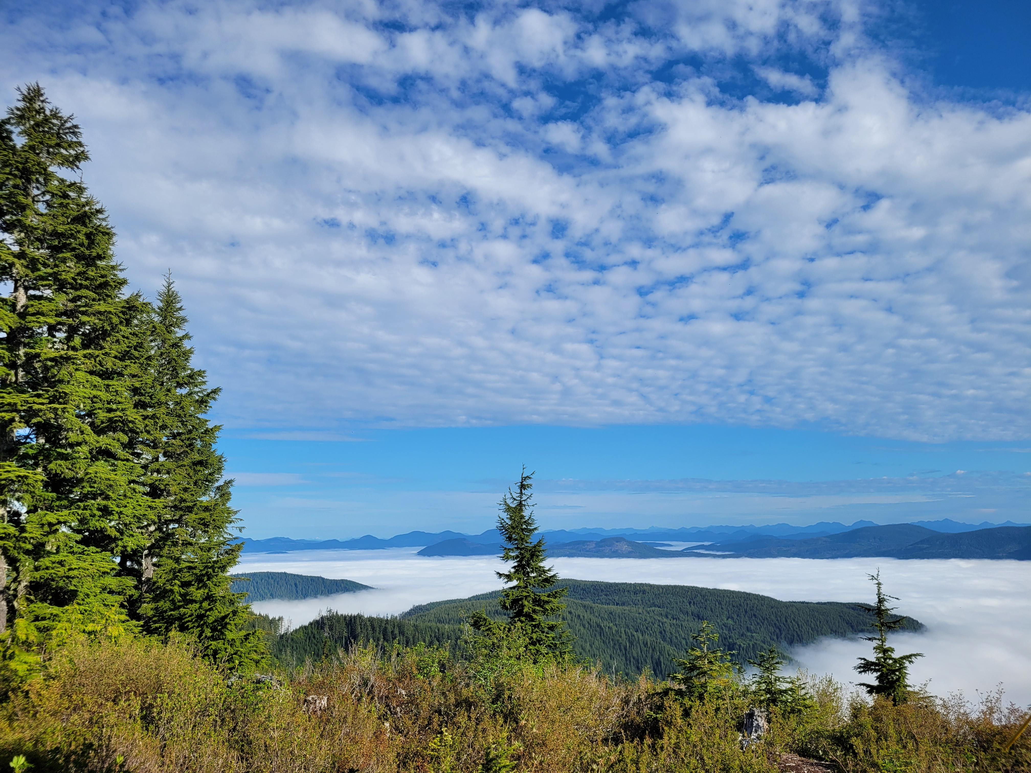

Tella
Cameron Gillingham
Aaron Huinink

Slide 2
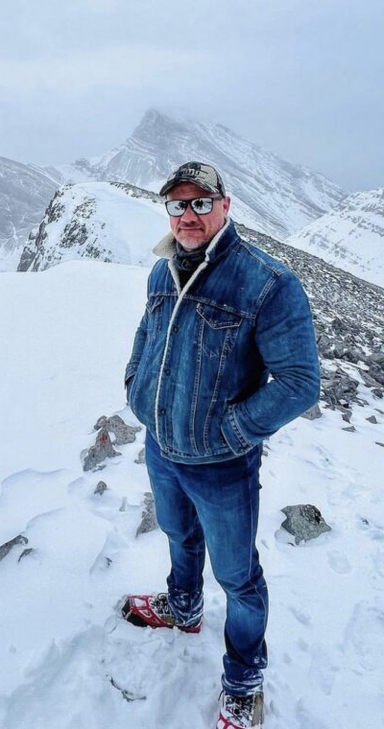

Checking in on Uncle Denim
Notes:
I’m sure you’re all very worried about uncle denim and dying to know whether or not we’ve developed a solution to ensure him and his banana haven’t disappeared into the the wilderness.
We’re happy to tell you…

Slide 3
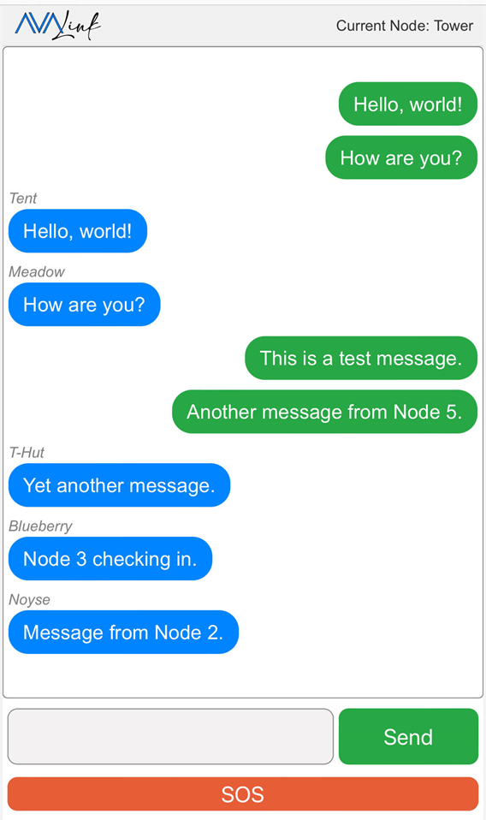
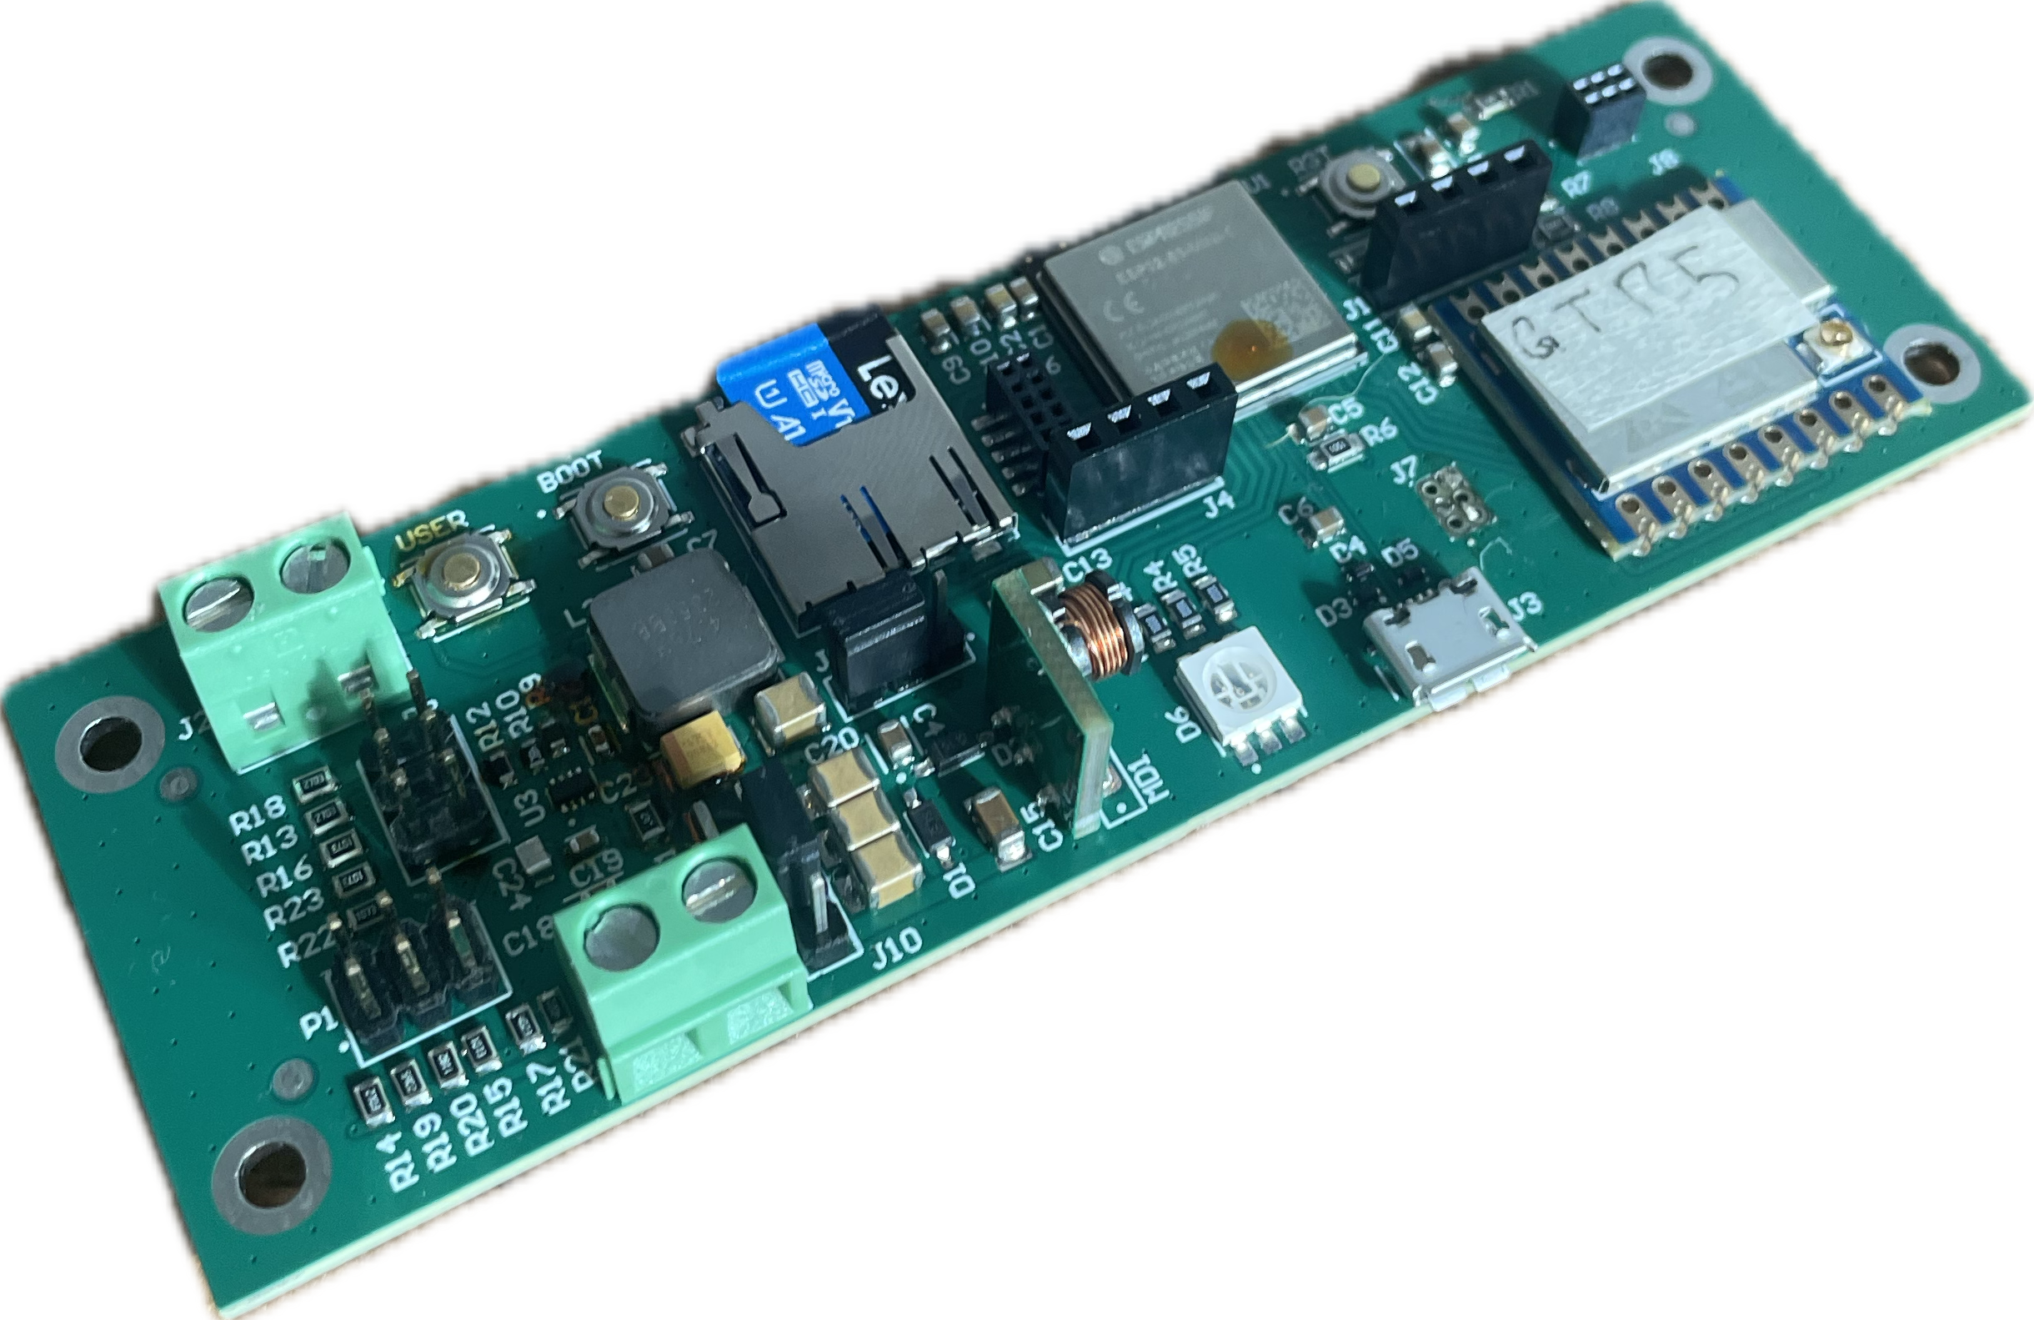
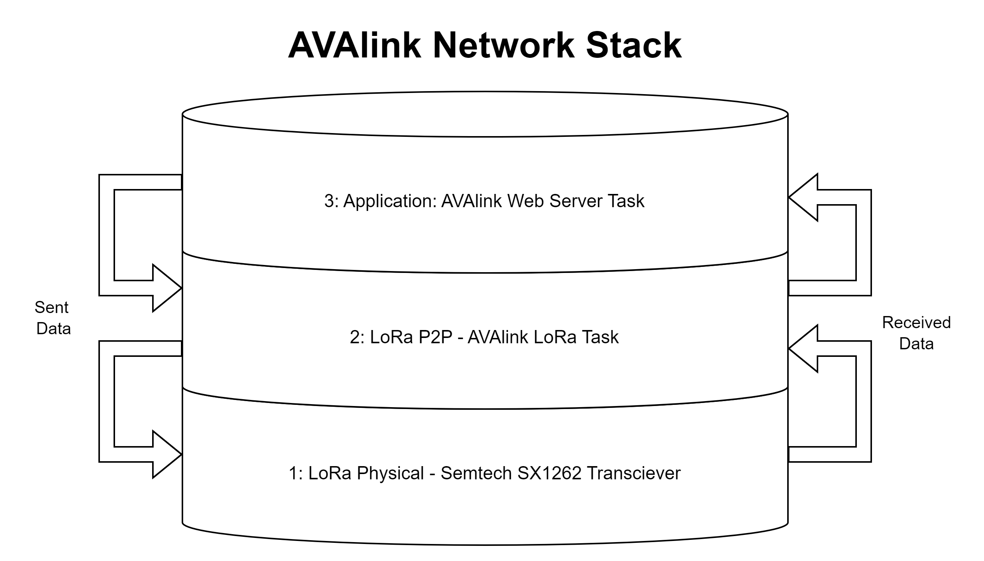
So, what have we been up to?
Built our first prototype
Created our web app
Designed our network stack
Notes:
-

Slide 4
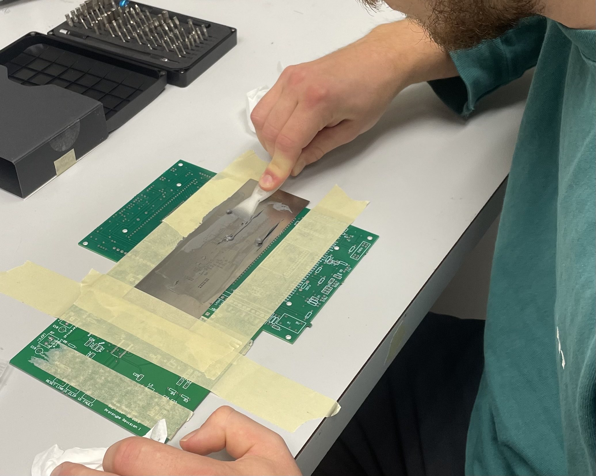
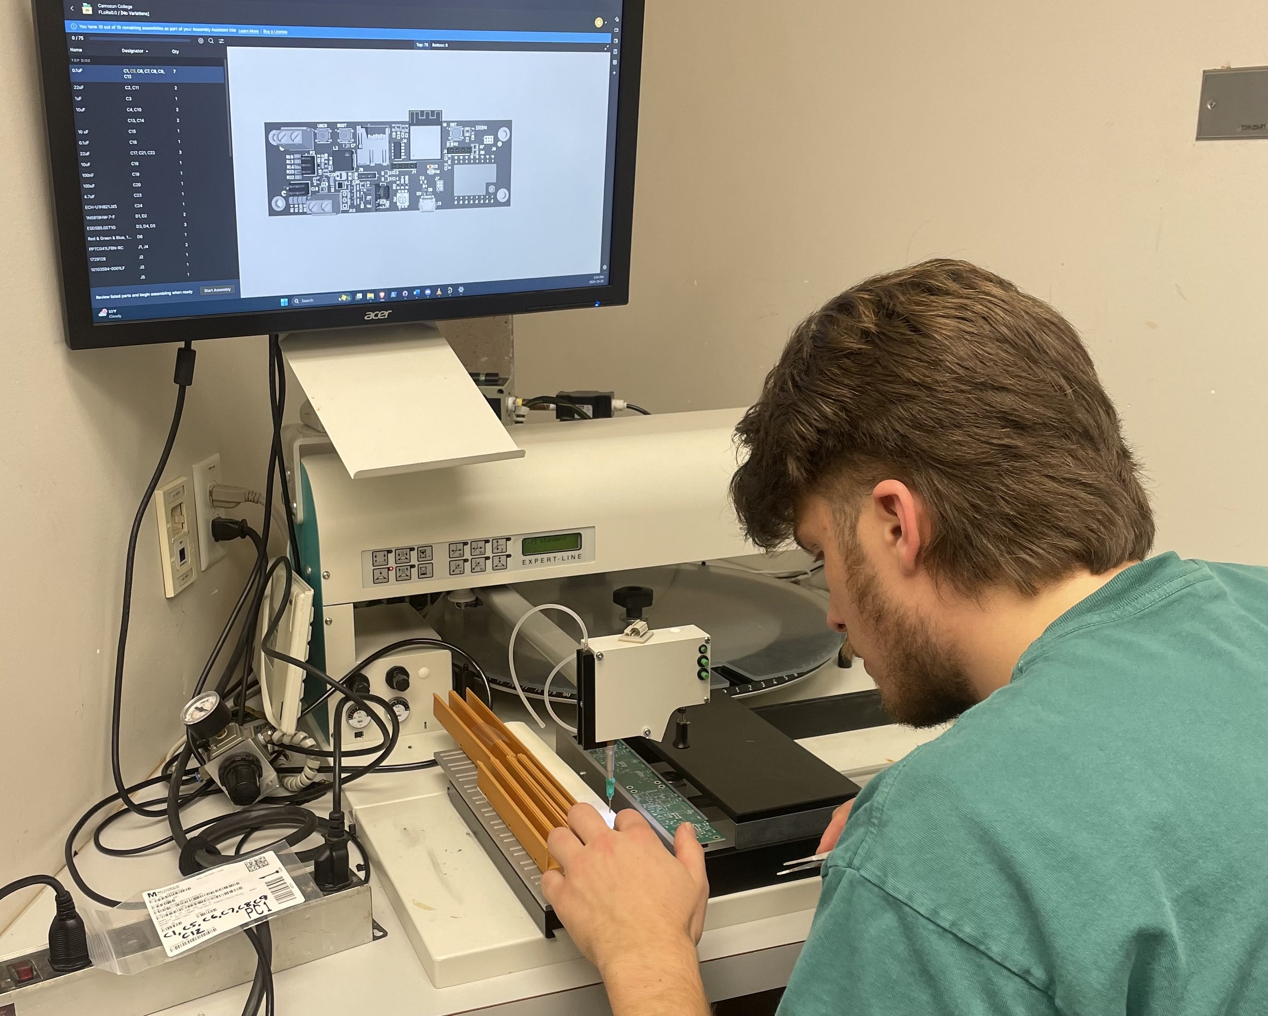
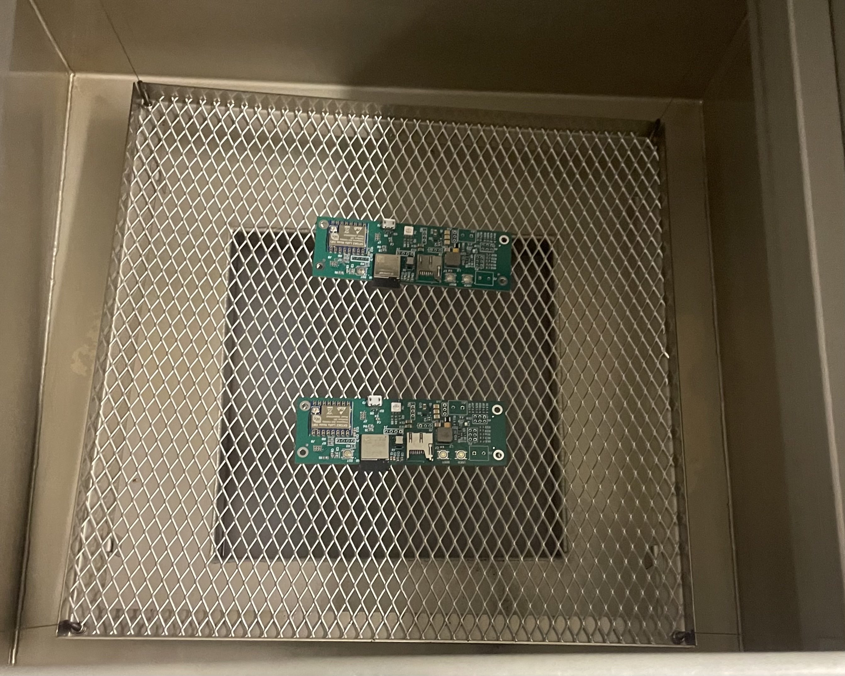
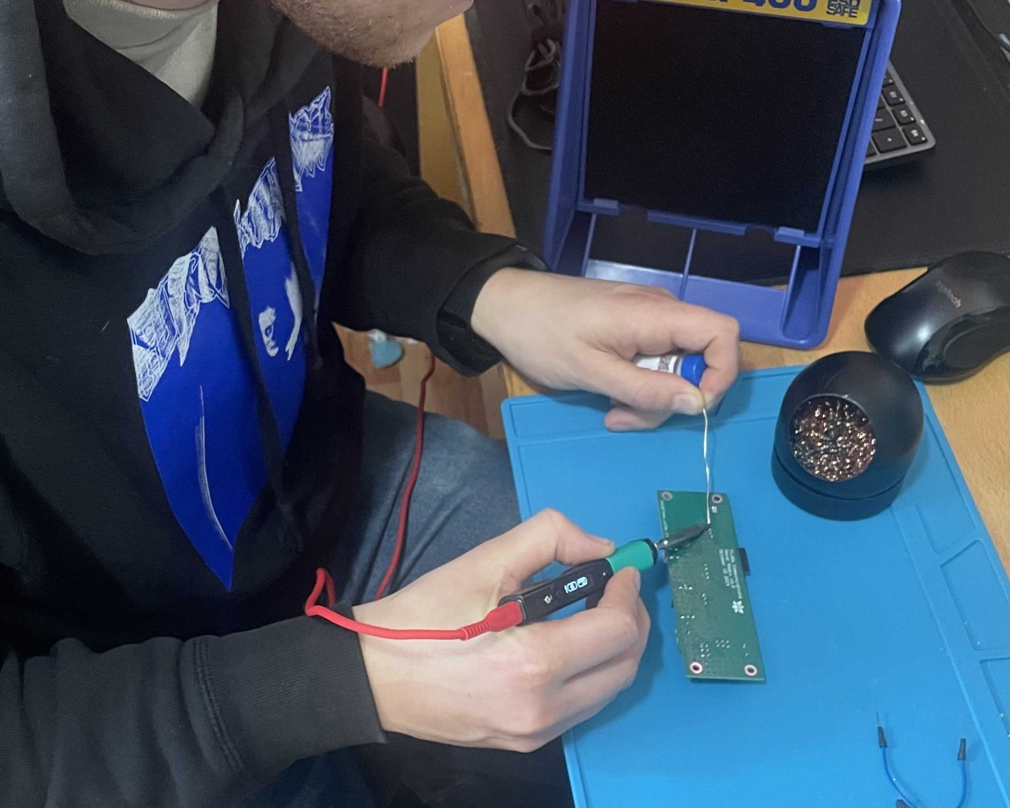
Building Our Prototype
Notes:
Redundancies
PSU
Firmware
Interfence, keeping radios apart
Efficiency
Data sheet graphs

Slide 5
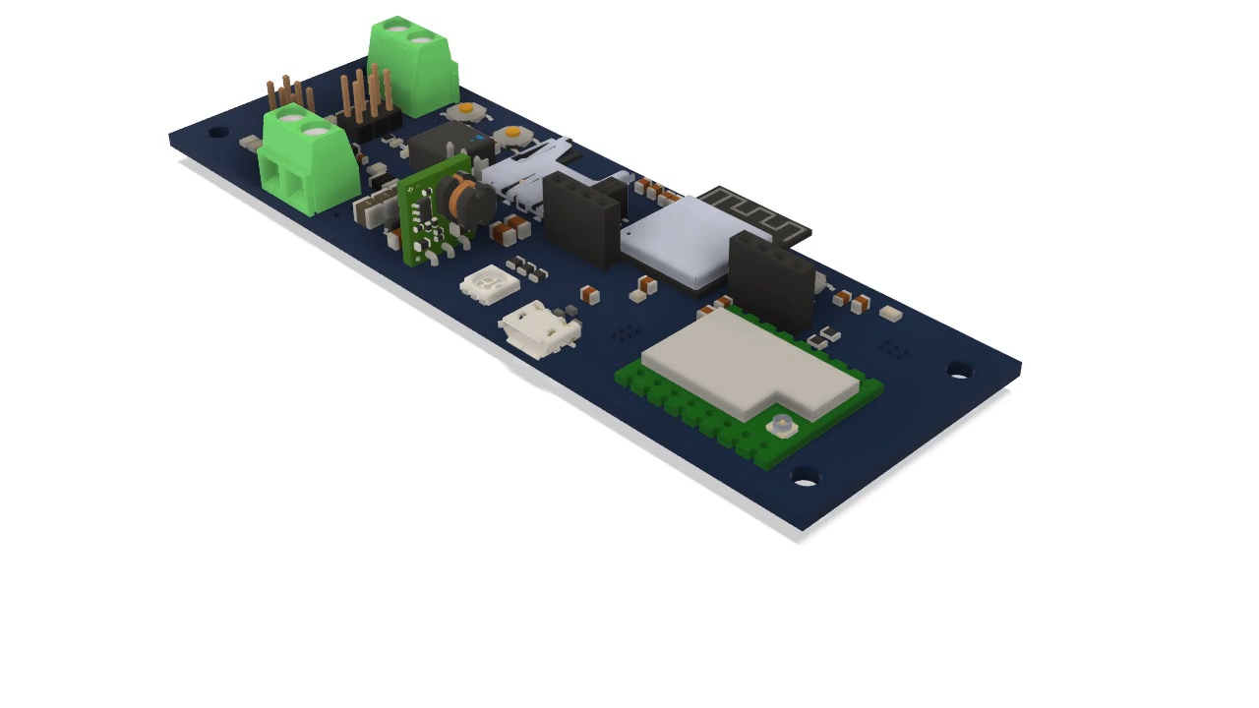
Petal Radio v0.0
SD Card
ESP32-S3 MPU
11.2 cm
Wi-Fi
Boot
Reset
Wi-Fi Breakout
UART
3.7 cm
GPIO & SPI Breakout
Battery Selection
RGB LED
USB
LoRa Module
Primary Power Supply
Back Up Power Supply
Notes:
1: empty
Board dimensions, we will want a smaller board but this is what we gotawe
2: Power Supply
3: SD card
4: ESP32
5: gpio spi
6: usb uart
7: bootons
8: radio
9: led

Slide 6
Notes:
Slide per pic

Slide 8
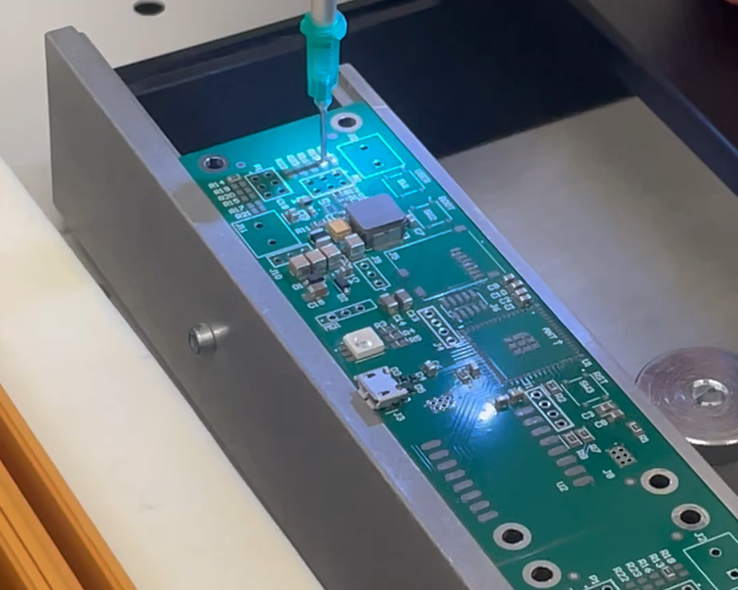

Slide 12



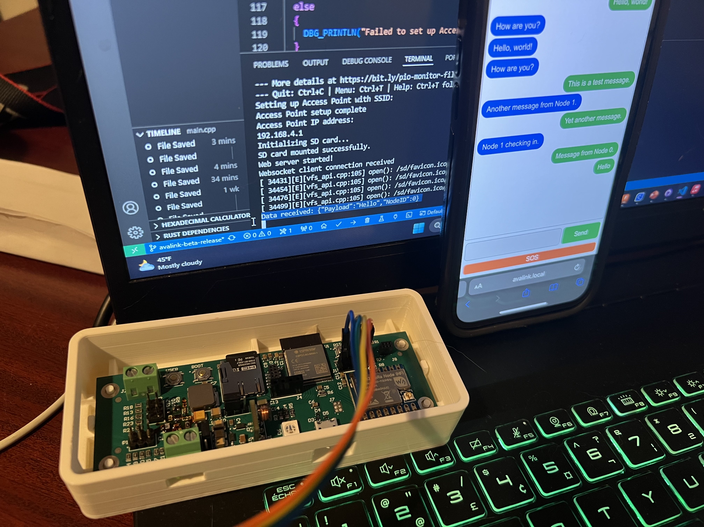

AVAlink Web App

Slide 13
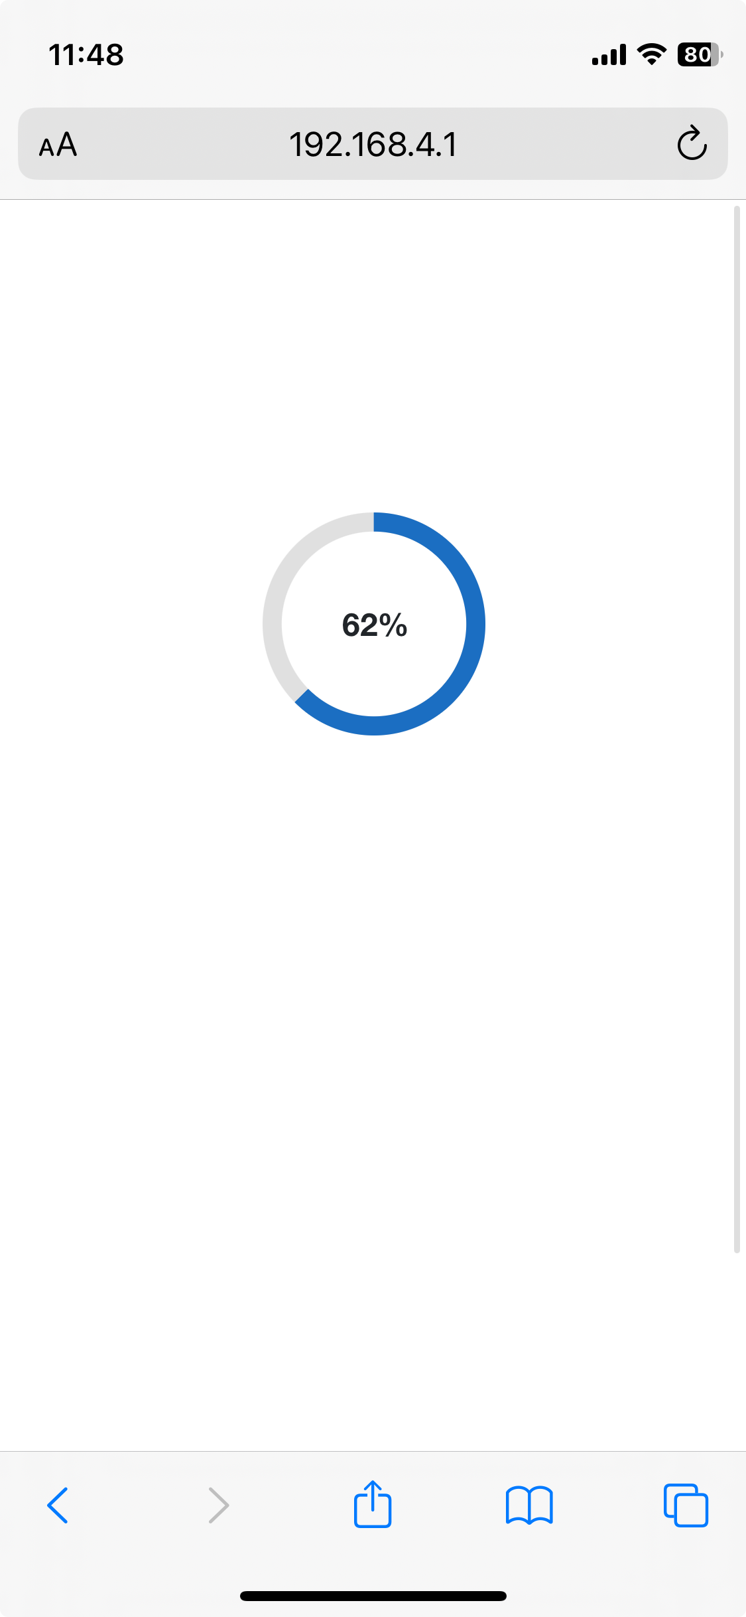


Choosing a framework
Blazor Application file size
Vanilla JavaScript file size
Blazor loading page hang-ups
Notes:
- Not a web developer
Sought out a framework to ease development, chose Blazor as it would expedite development and leverage experience with .net/C#
This came with the cost of large application files, we were unable to serve the apps we had written with the Blazor via the ESP32 so decided to switch to a traditional web development approach t
We knew was proven to have worked

Slide 14
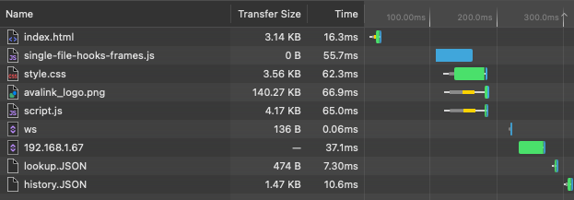
Deployment Timing
Network tab from Safari developer tools

Slide 15

Familiar Layout
Connected Node Identifier
Received messages on left of chat window
Sent messages on right of chat window
Node identifier stamp on received messages
Send button matches colour of Sent messages
Large Accessible SOS button

Slide 16
AVAlink Firmware
Notes:
Redundancies
PSU
Firmware
Interfence, keeping radios apart
Efficiency
Data sheet graphs

Slide 17
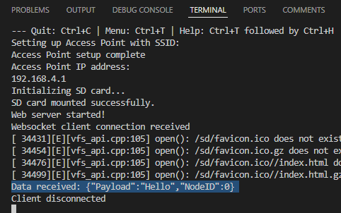
Serving AVAlink
Serving AVAlink from Petal Radio v0.0

Slide 18

Our network stack
Sent Data
Received Data
Notes:
what is a stack
Layer 1
Layer 2
Layer 3

Slide 19
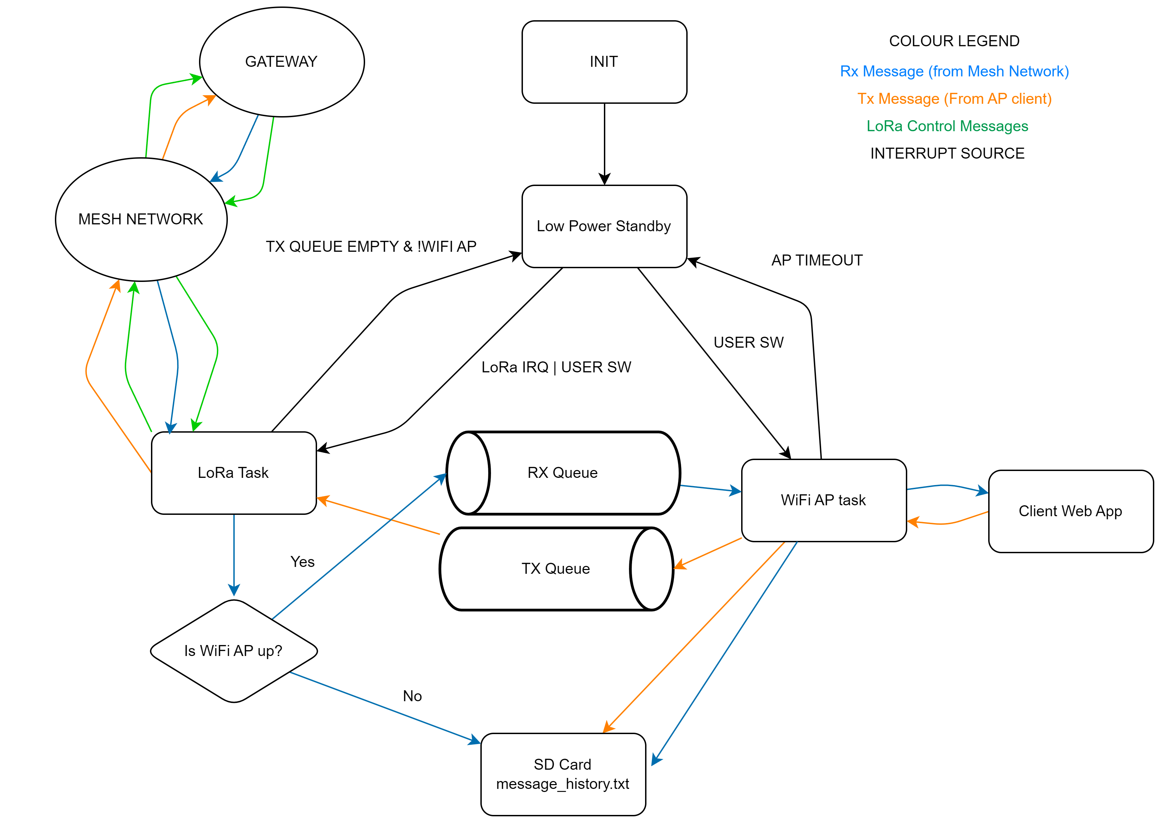
AVAlink firmware overview
Notes:
Main takeaways from this flow chart:
We can do each of these things individually, and now we will be integrating them.
Tie into hardware decisions, (dual core, etc.)
Open source libraries cover each task
Next steps are implementing our designs

Slide 20
So what?

Slide 21
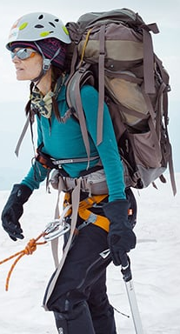
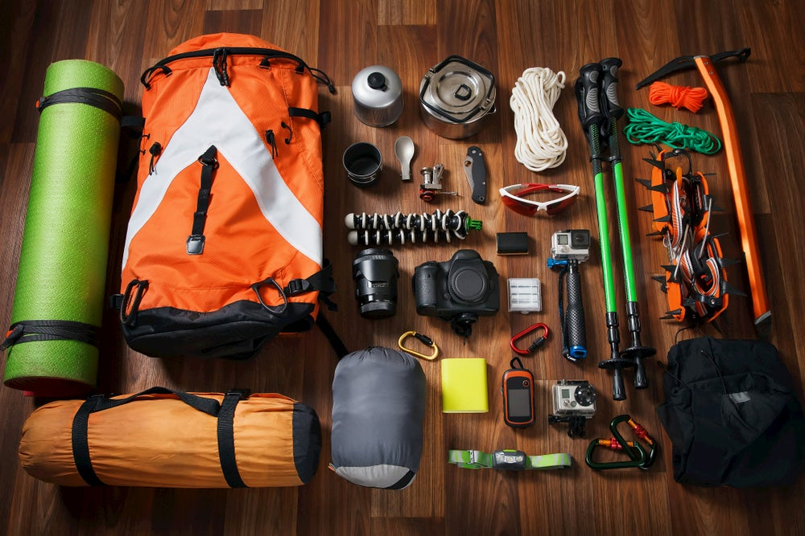
What do these hikers have in common?
Notes:
Is It OK To Hike In Jeans? (>800 Hikers Weigh In!) - Chasing Summits

Slide 22

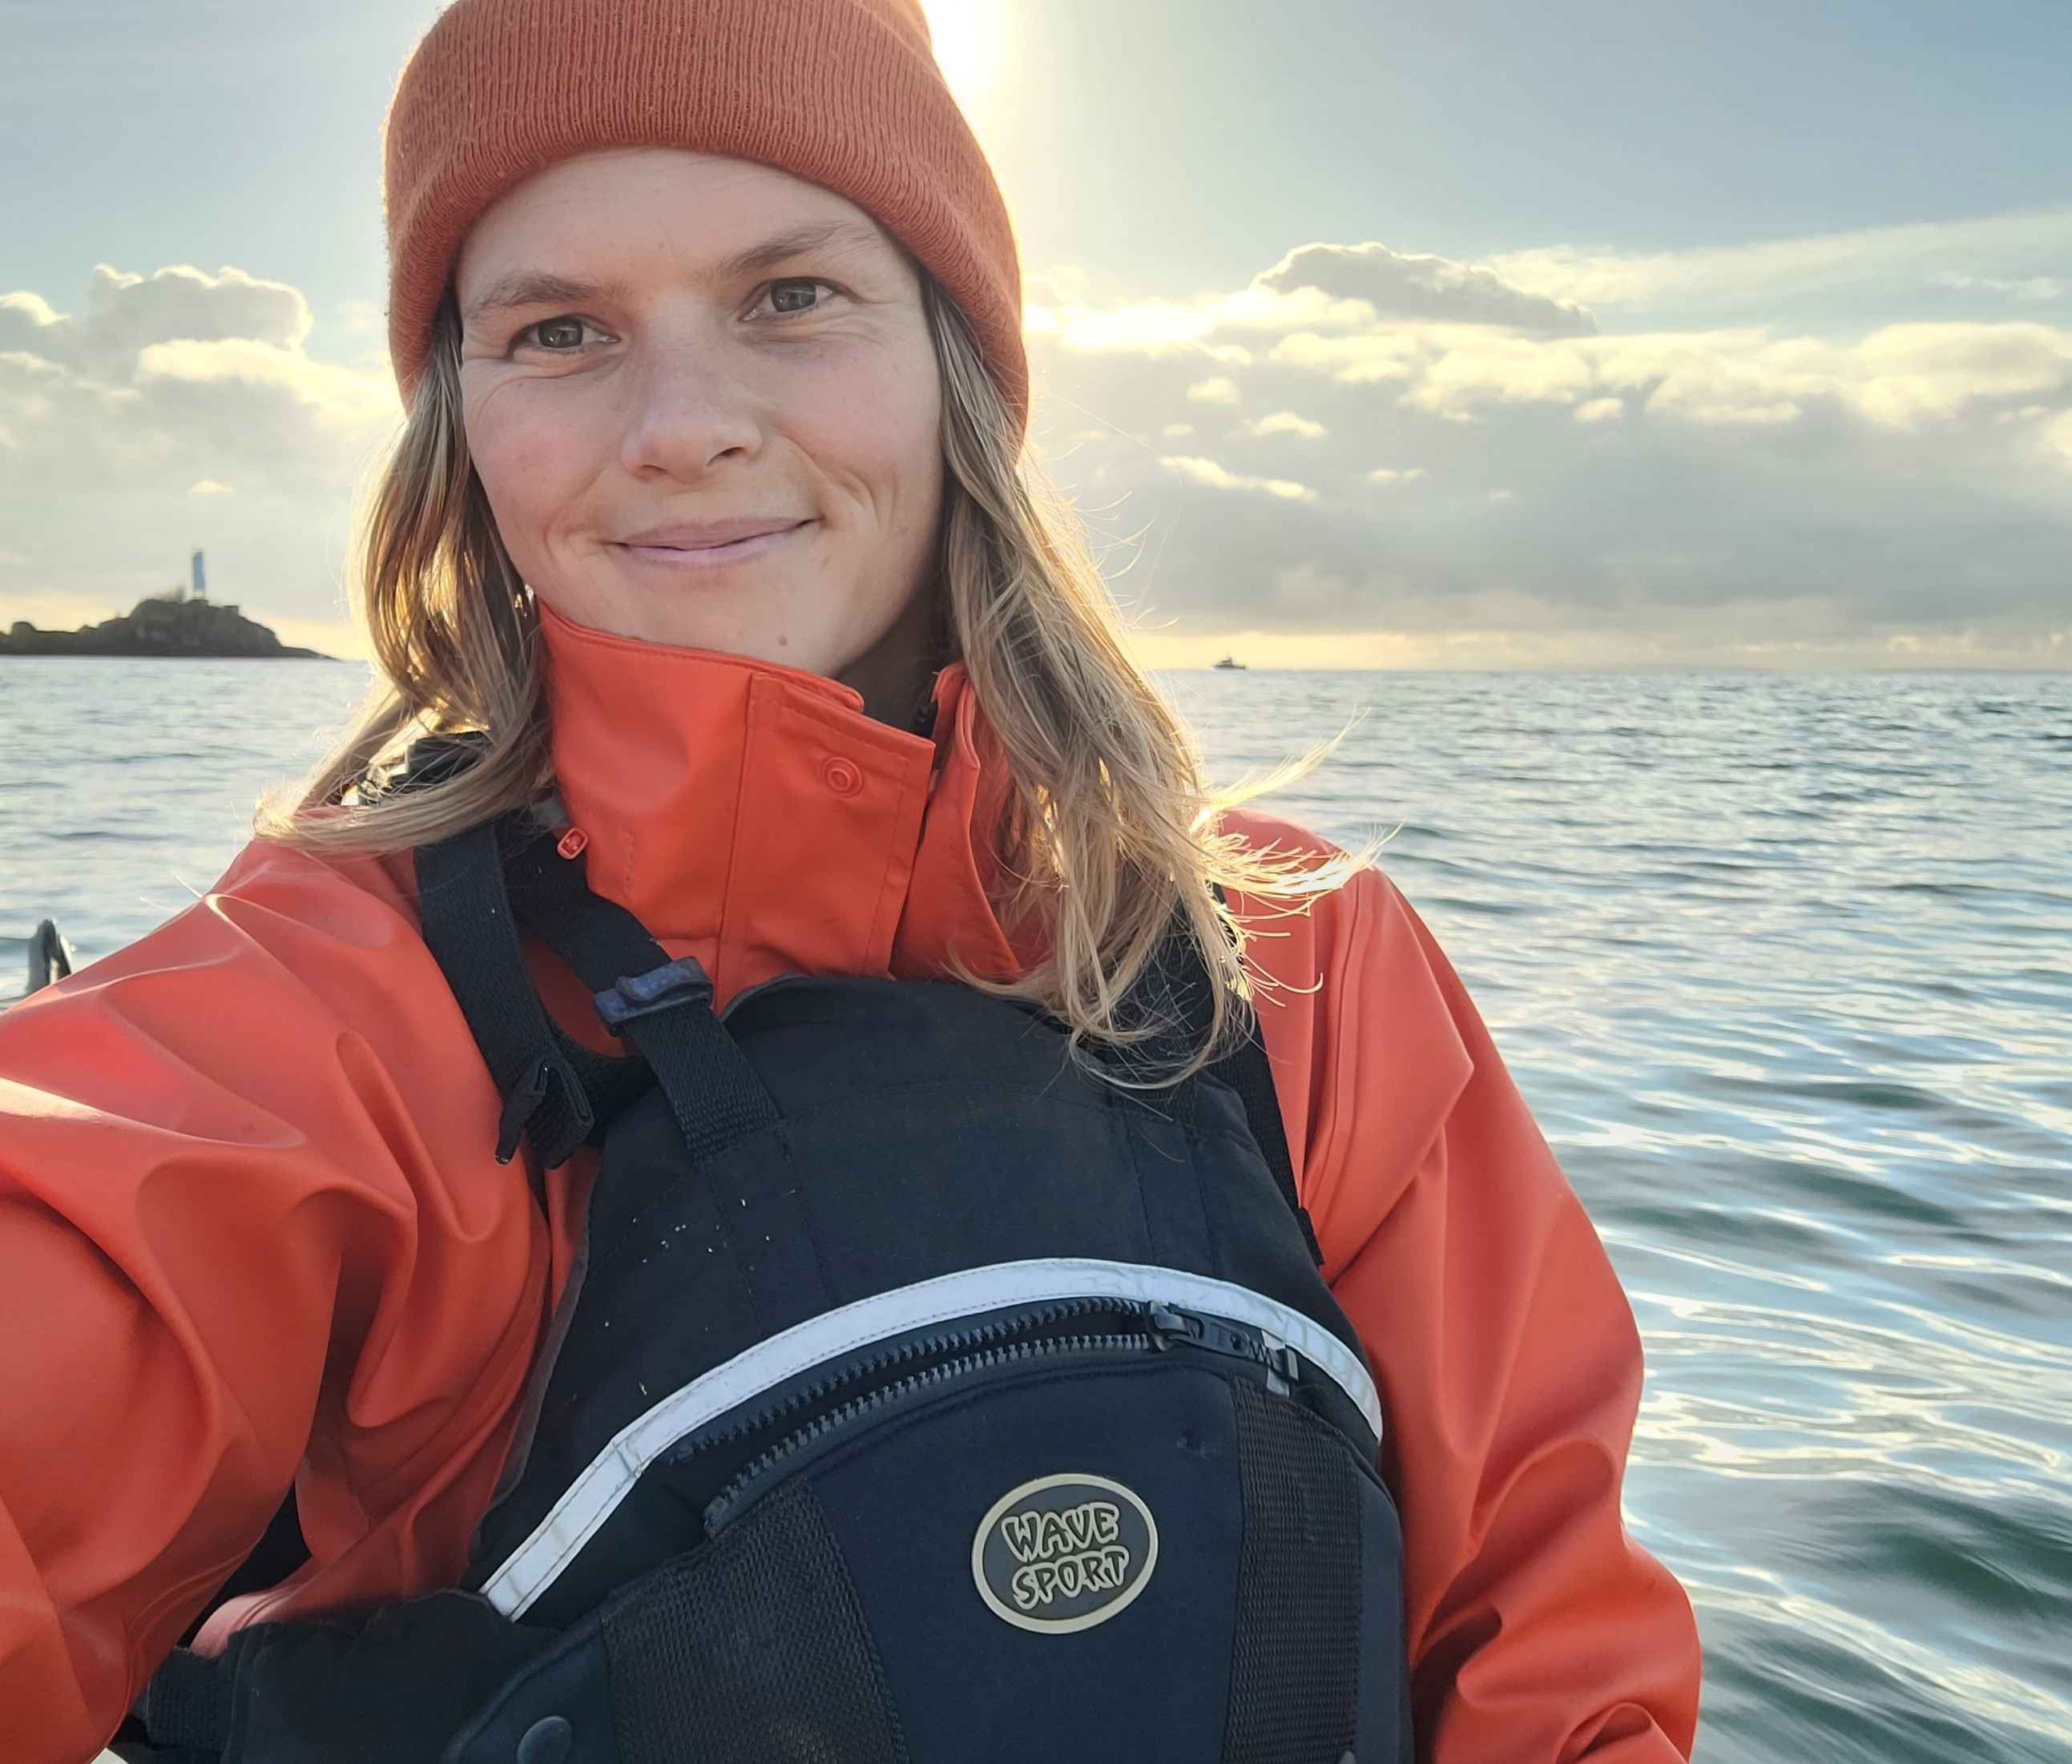
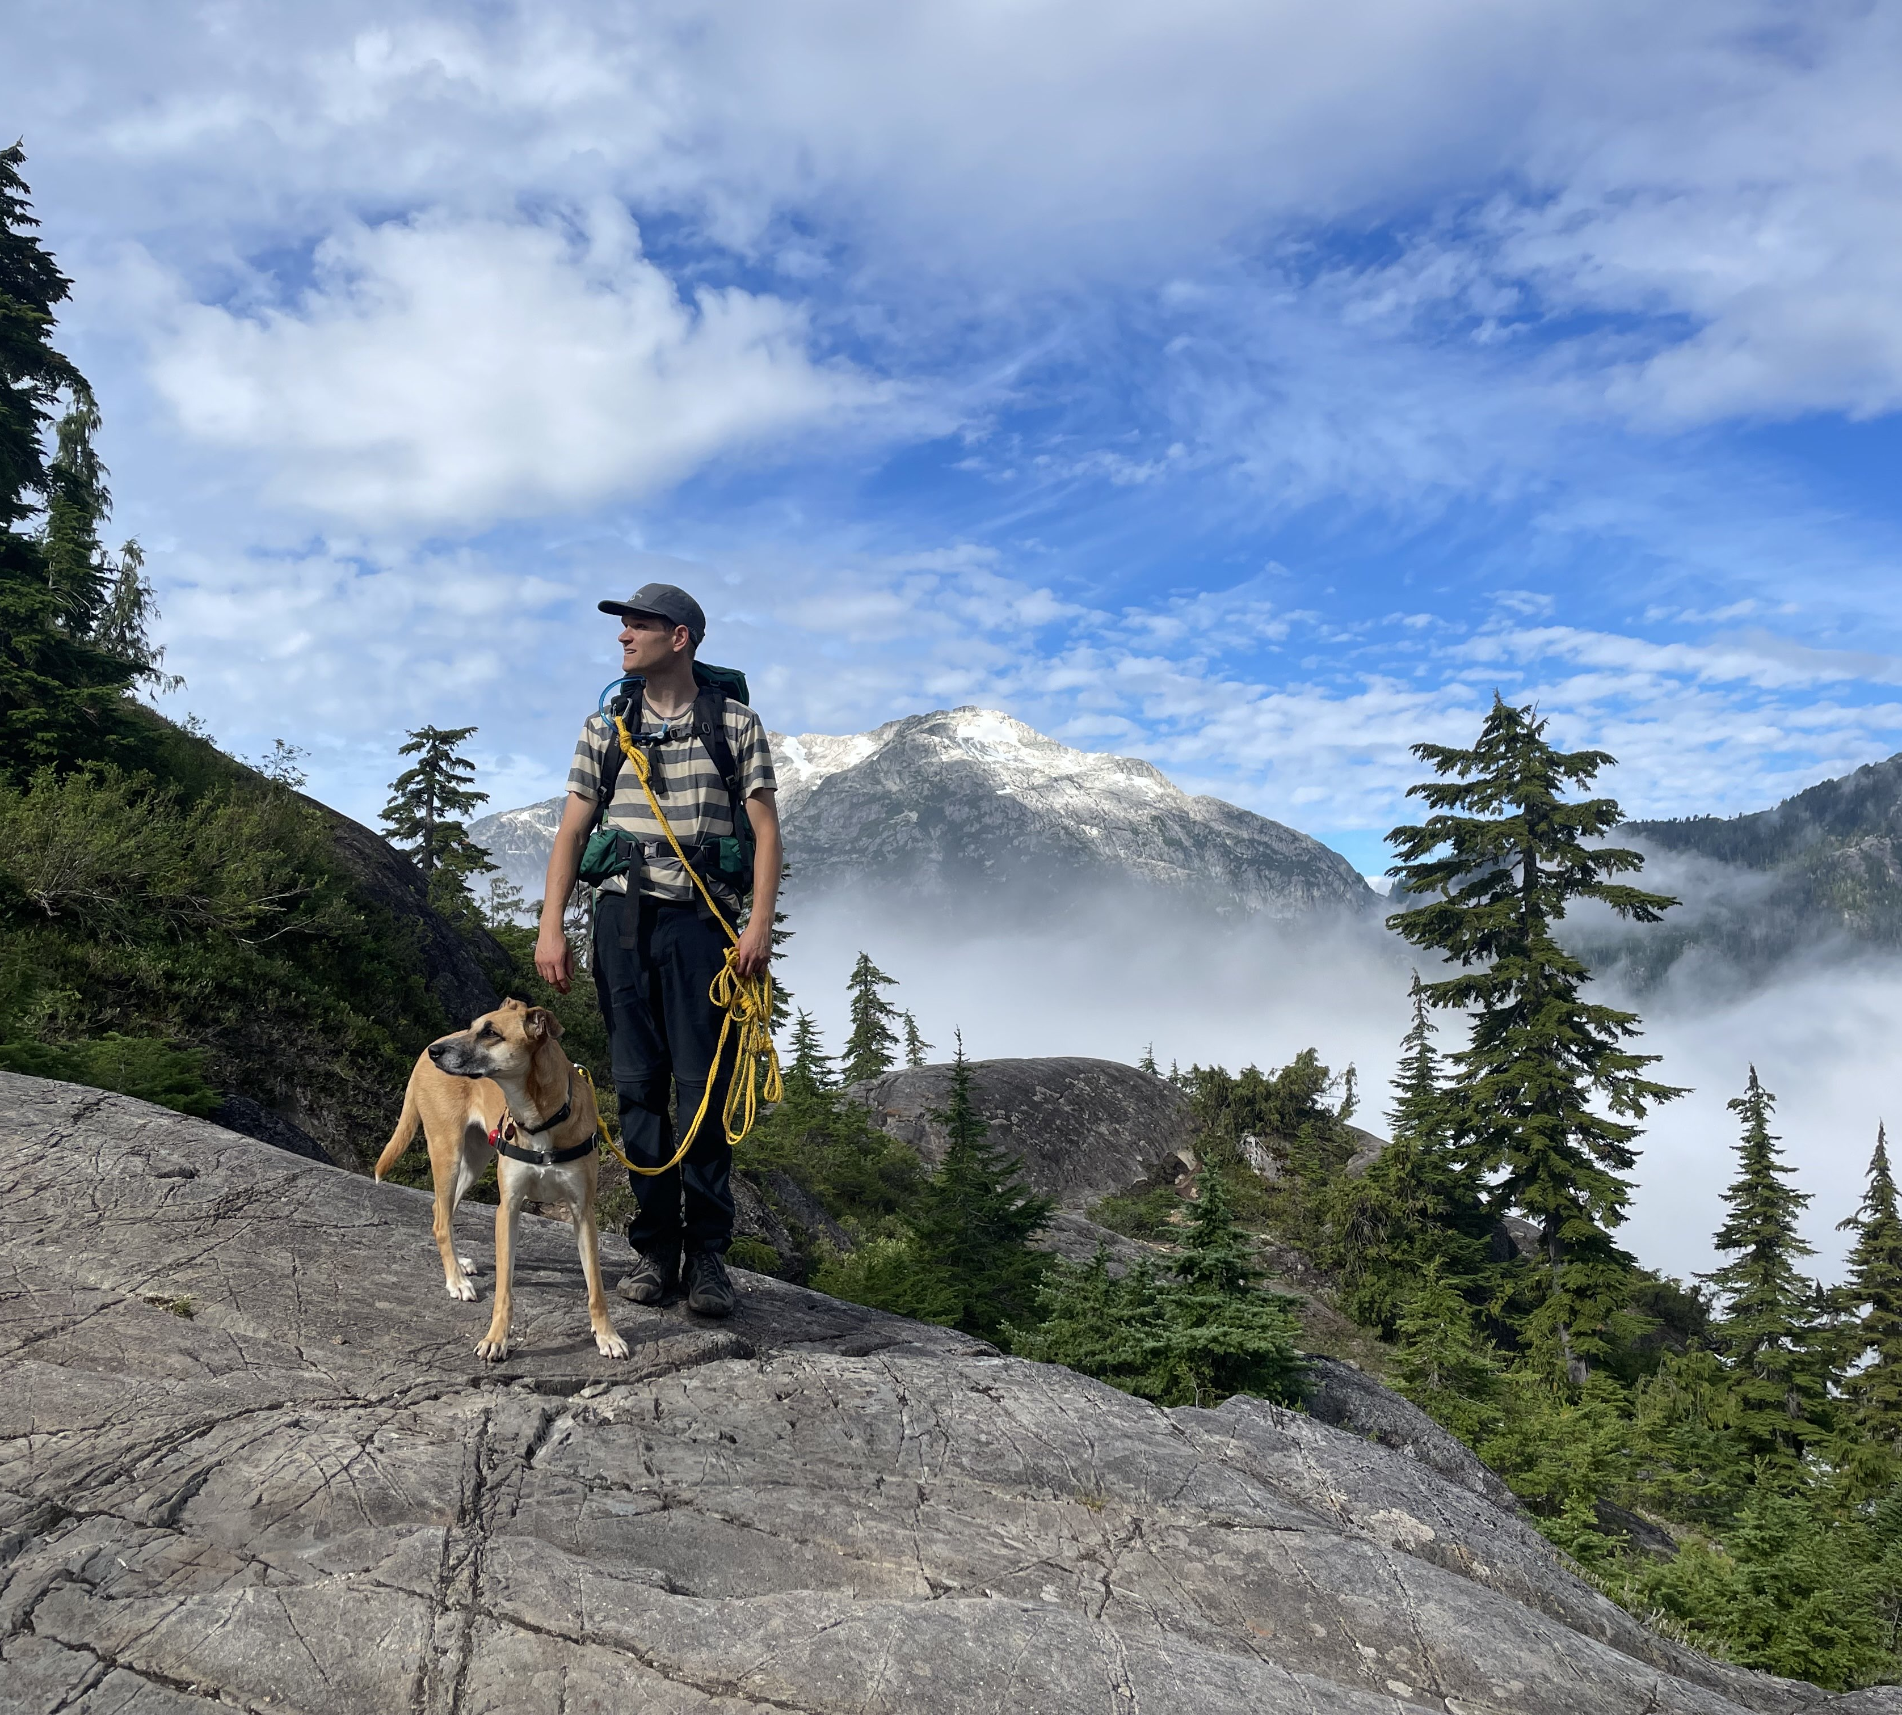
Our Team
Aaron Huinink
Tella Osler
Cameron Gillingham
Notes:
Our Team

Slide 23
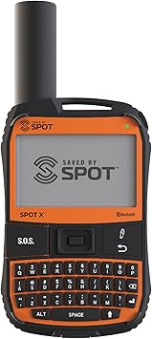
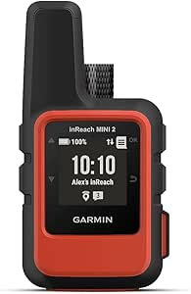
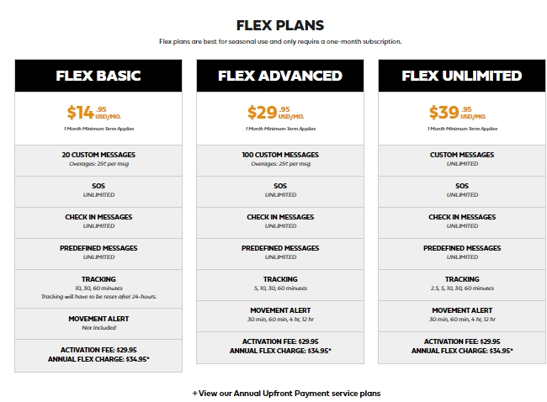
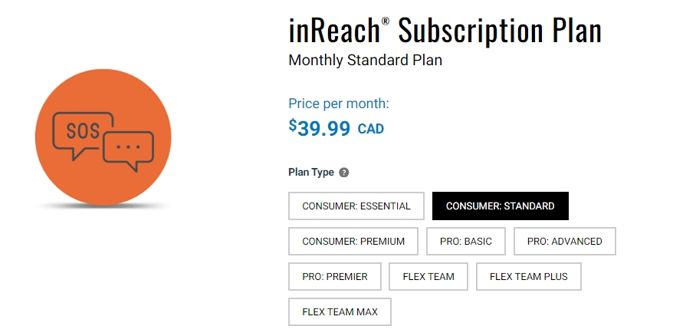
Plug & Play Solutions
GARMIN INREACH
$ 519 CAD
(amazon.ca)
SPOT X
$ 349 CAD
(amazon.ca)

Slide 24
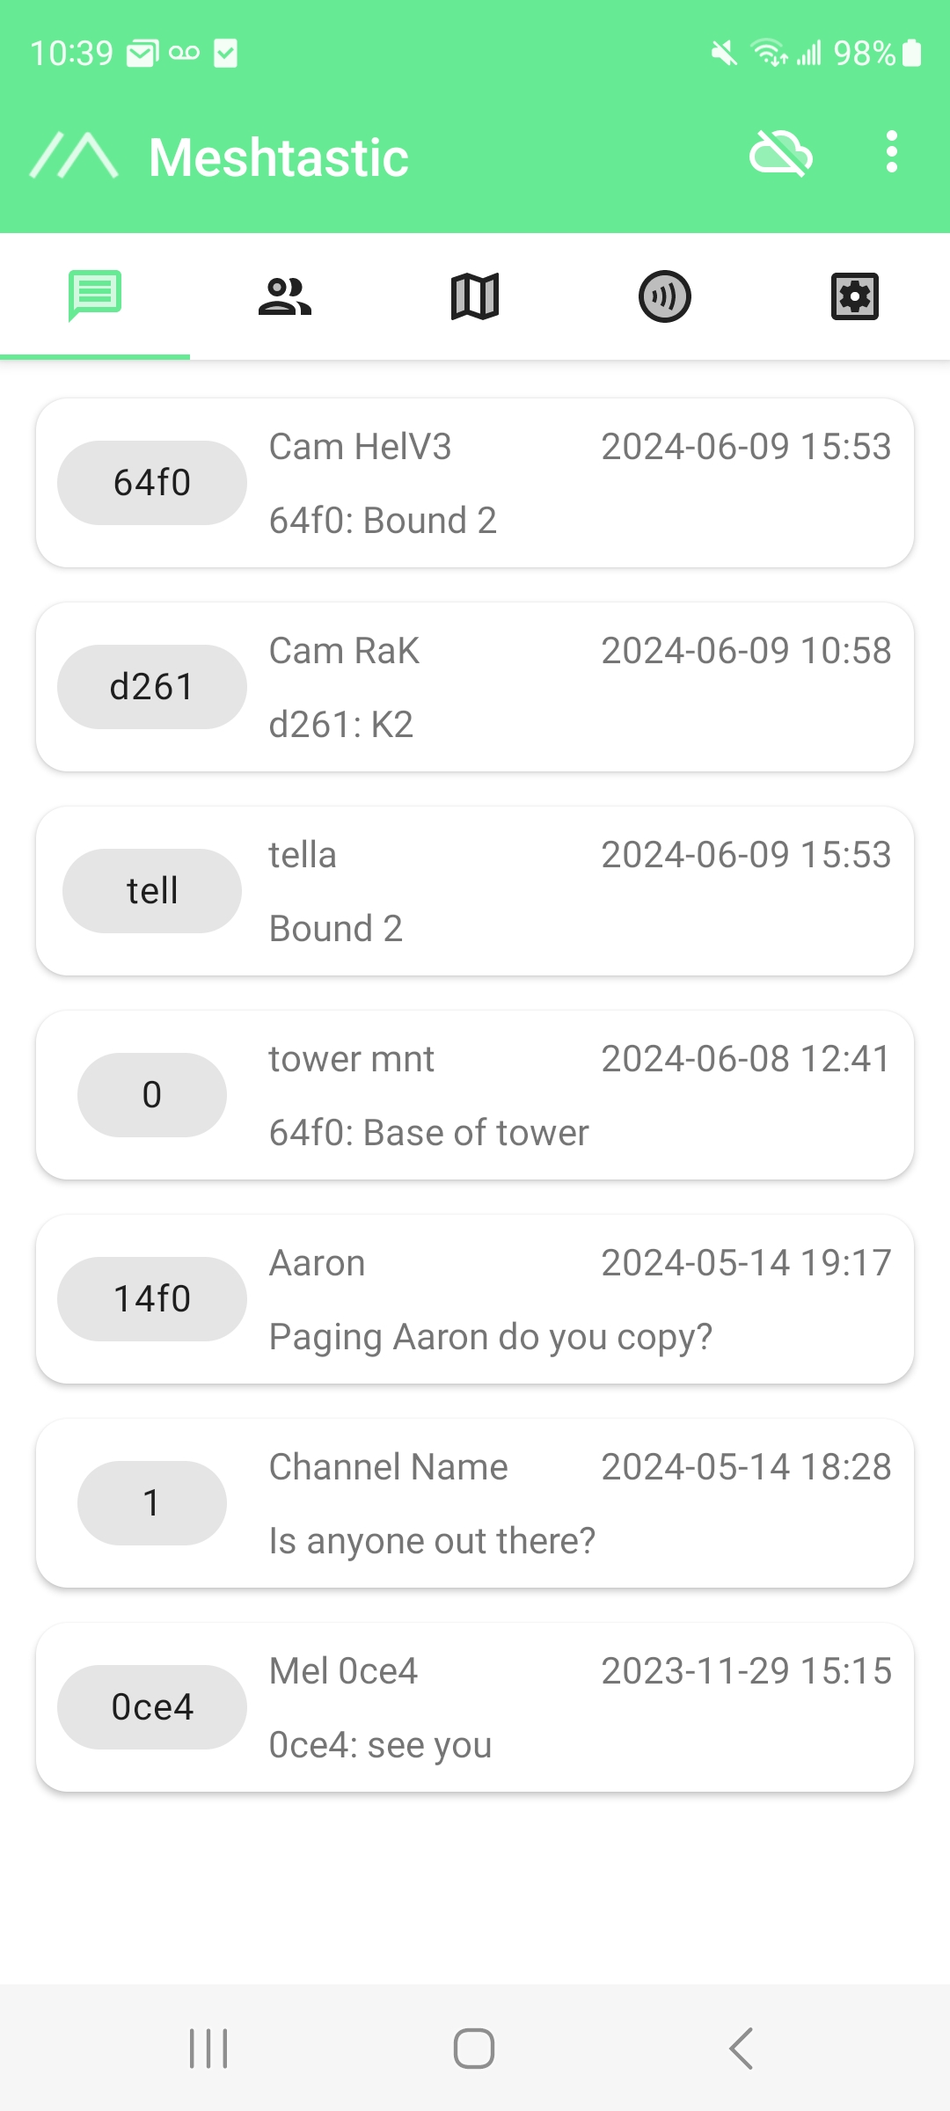
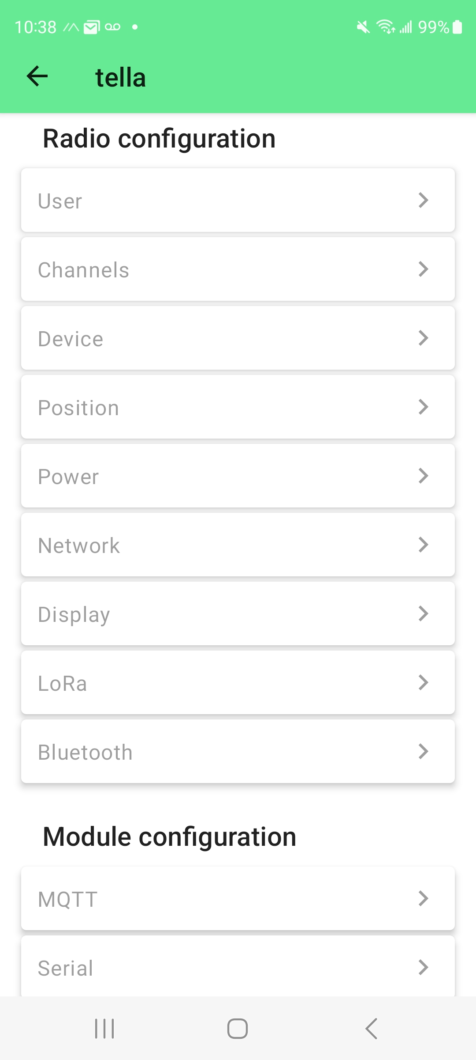
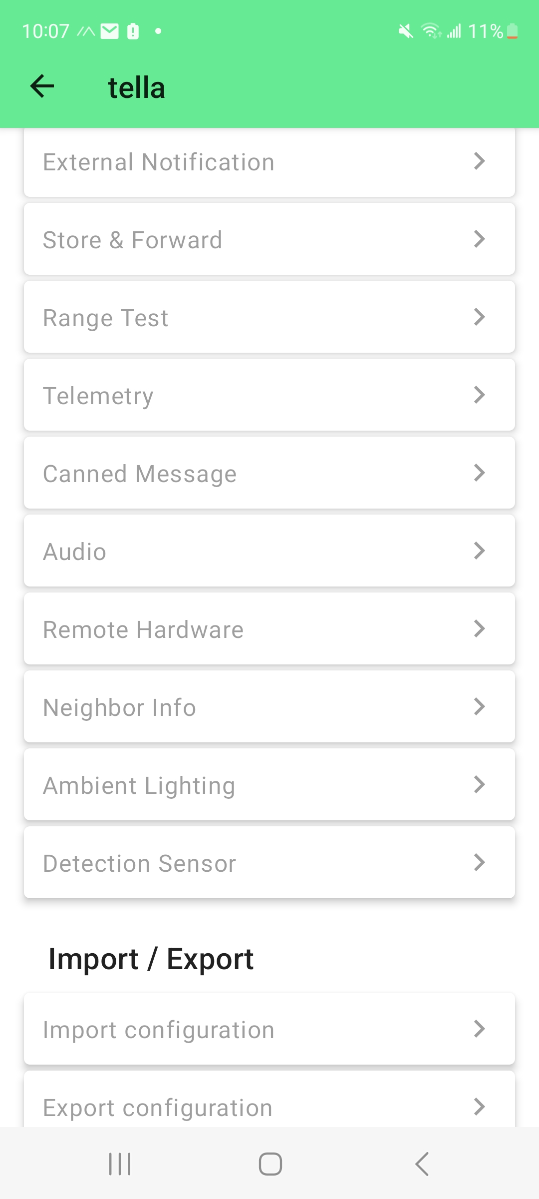
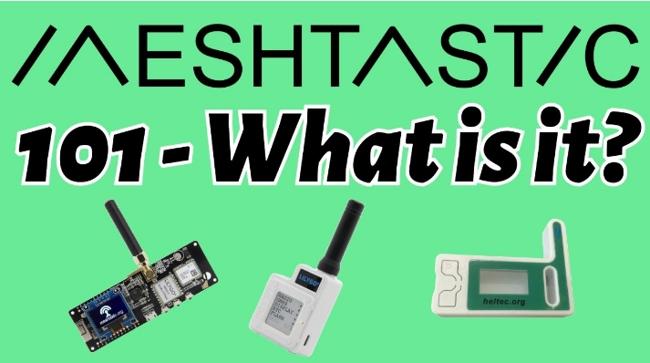
Tech-Savvy?

Slide 25
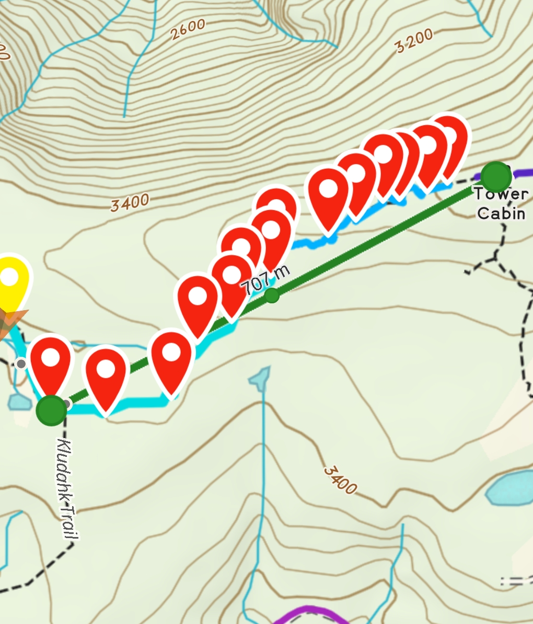
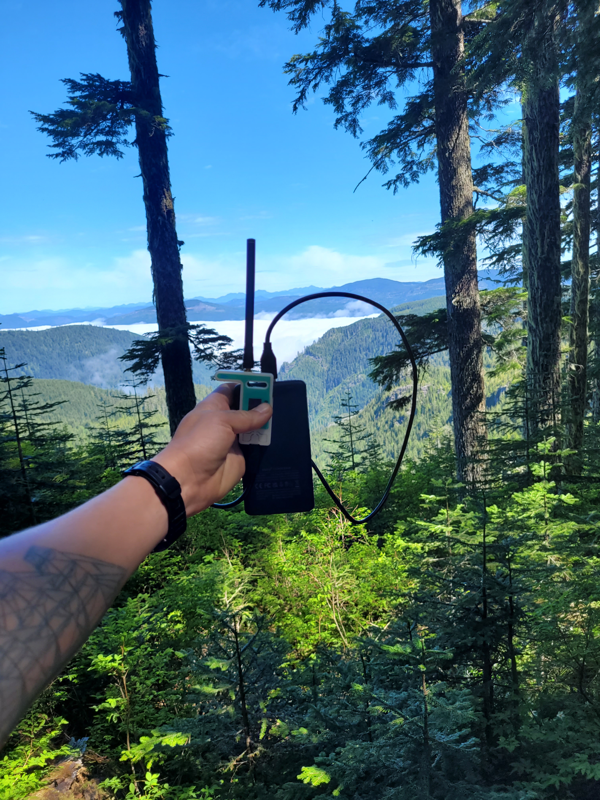
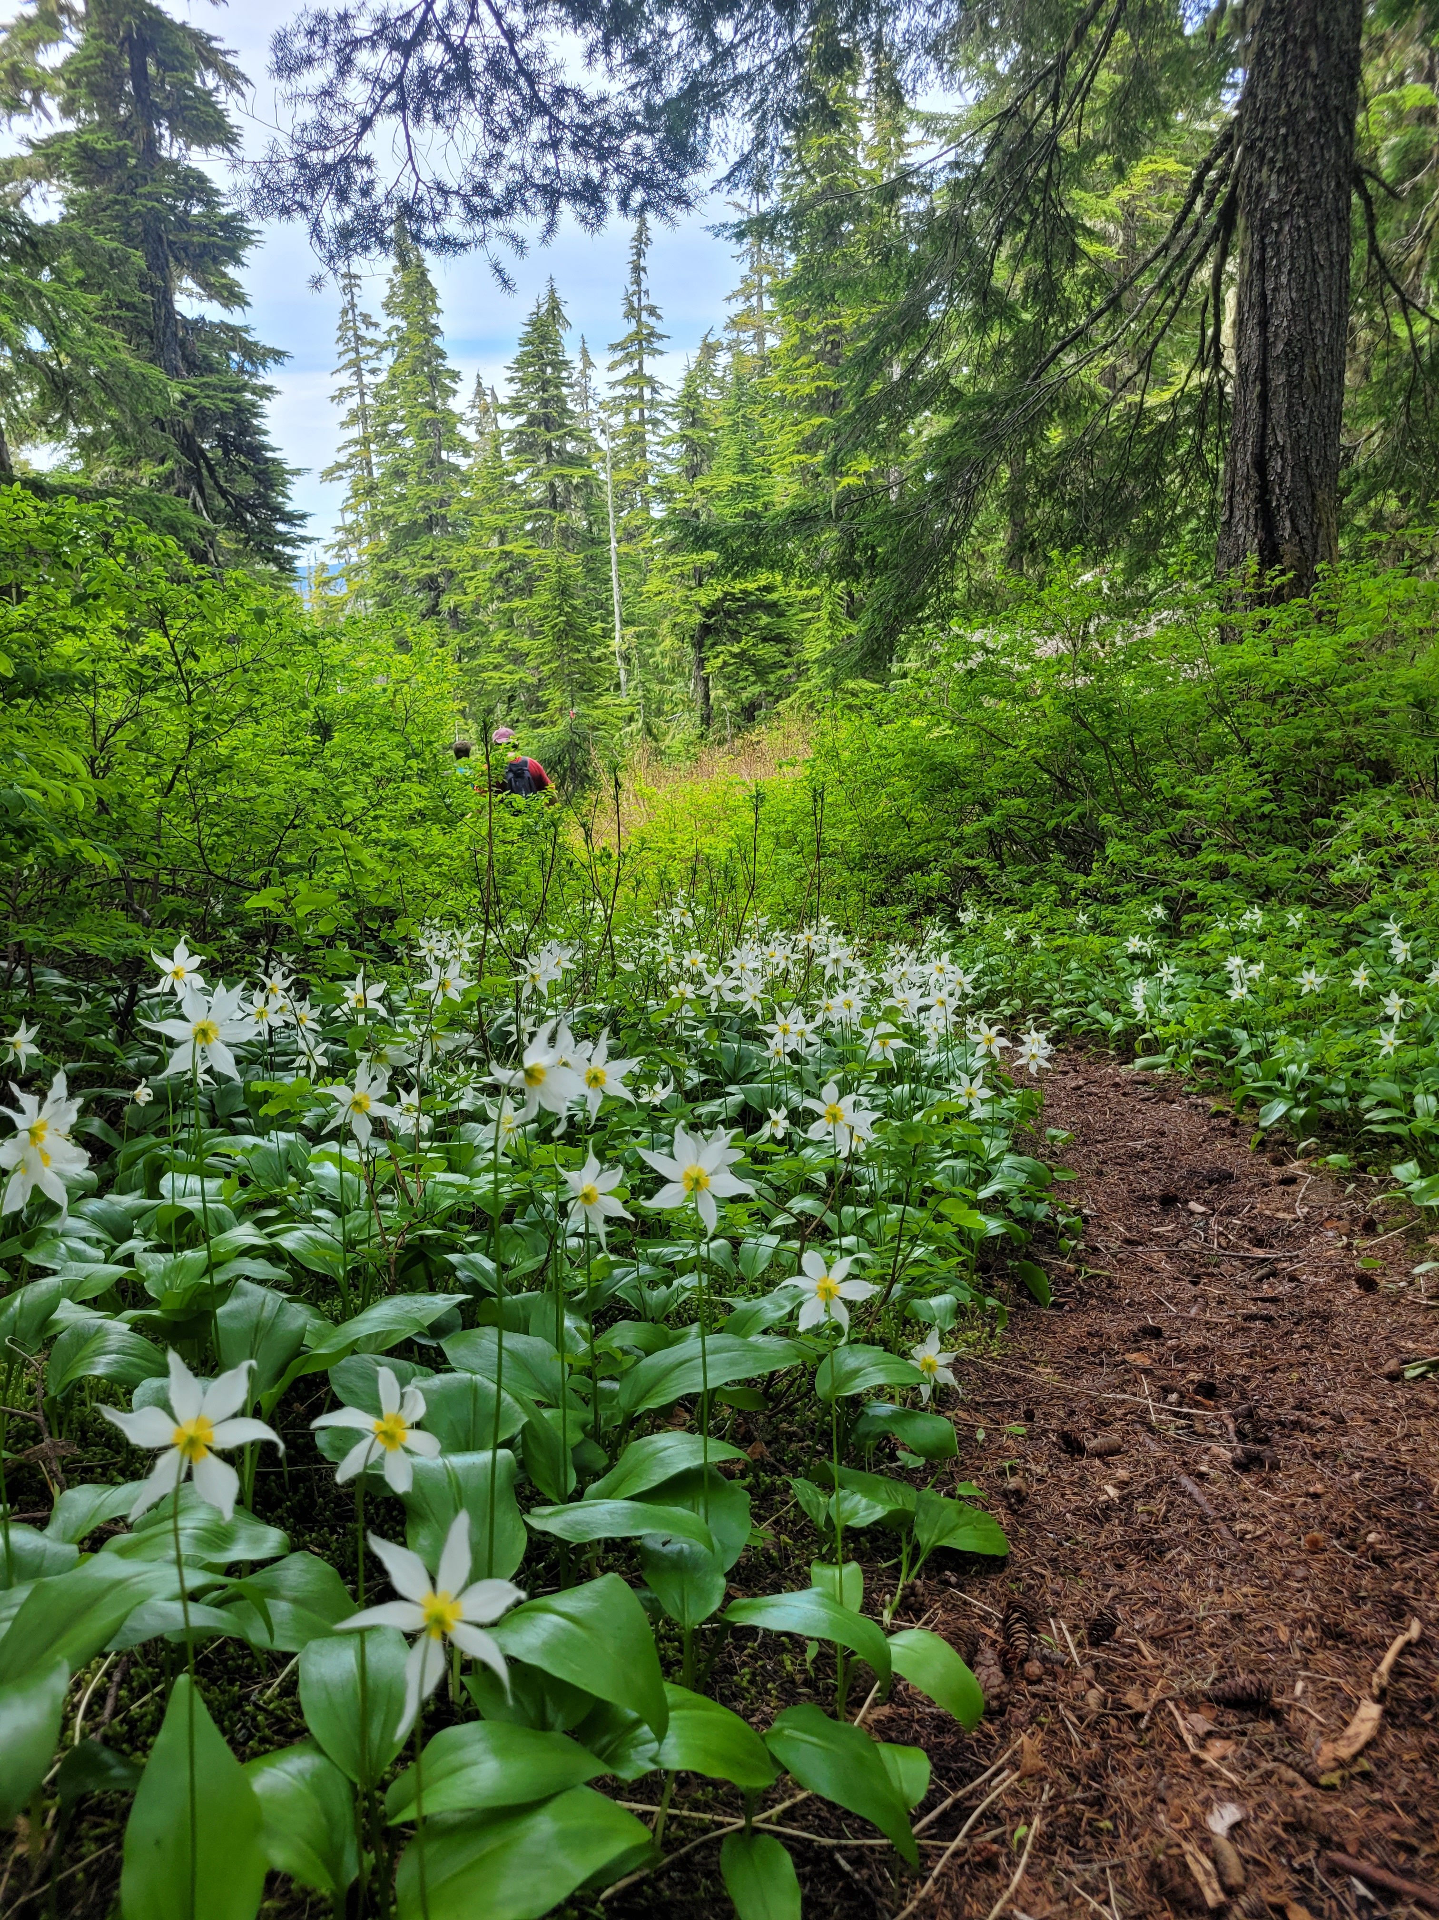
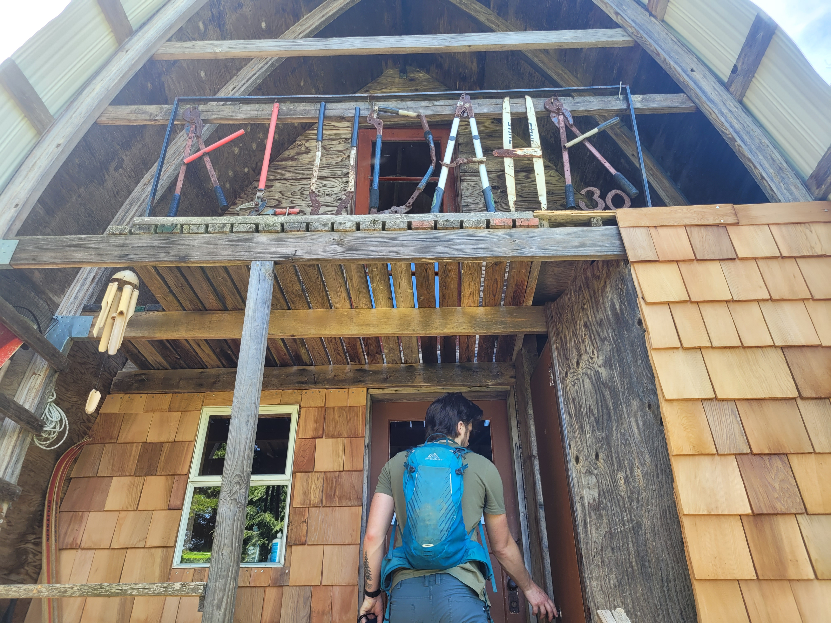
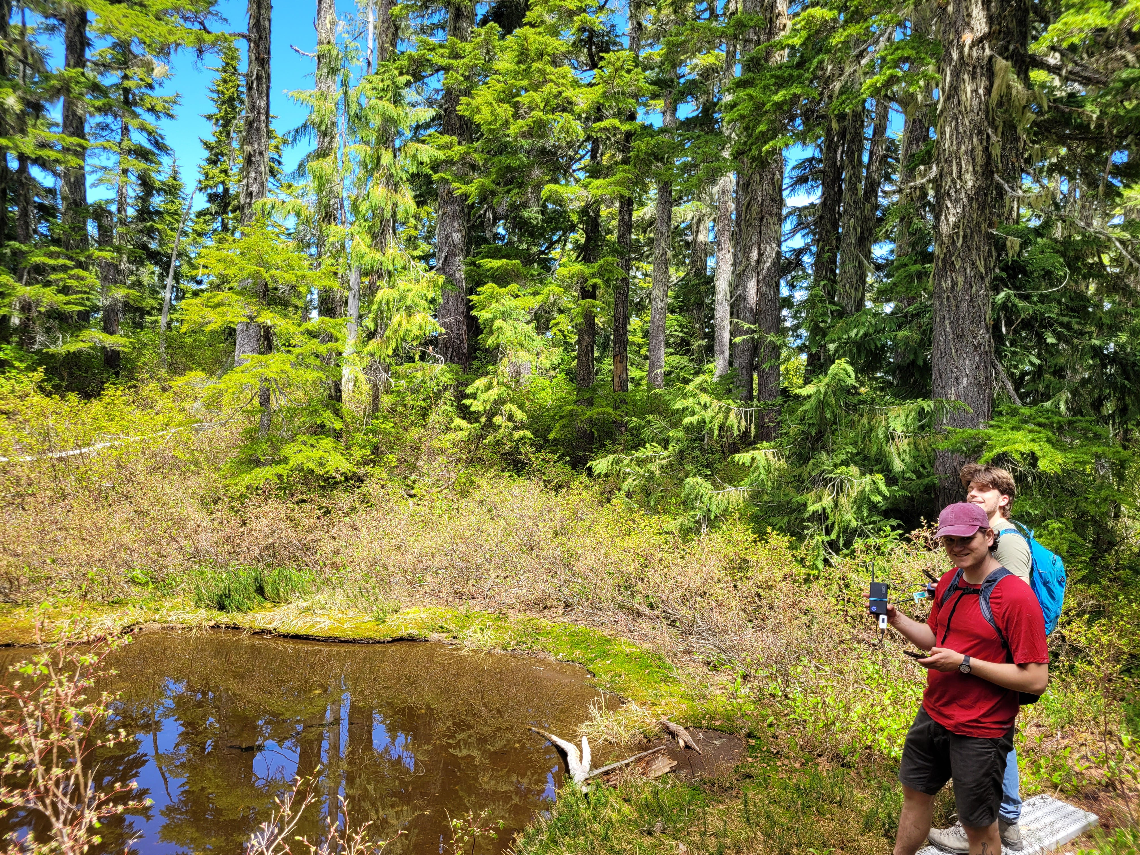
Proving Feasibility

Slide 26


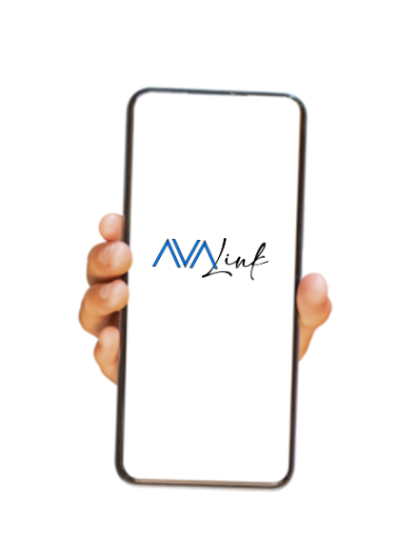
Our Solution
Petal
Digital Radio
Petal
Digital Radio
Petal
Digital Radio
LoRa
LoRa
Wi-Fi
Wi-Fi
Wi-Fi
Notes:
We are designing a LoRa-capable digital radio (Petal) and a full-stack repeater network solution called AVAlink. Instead of requiring users to have an expensive satellite device, our repeaters will host a browser-based web application so that anyone with a smartphone can access the network. Users will send messages via the Avalink web application which will be transmitted along the mesh network and accessible by other users. In the future, we hope to integrate our network with existing emergency services, like search and rescue and 911.

Slide 27
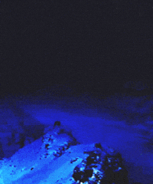
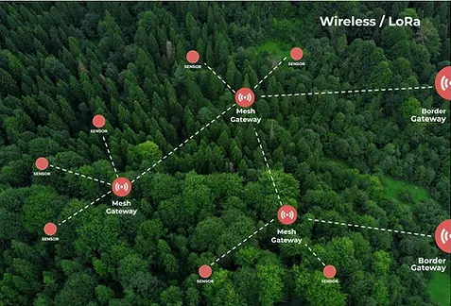
Mesh Network
Notes:
LoRa Mesh Network
So what is a mesh network?

Slide 28
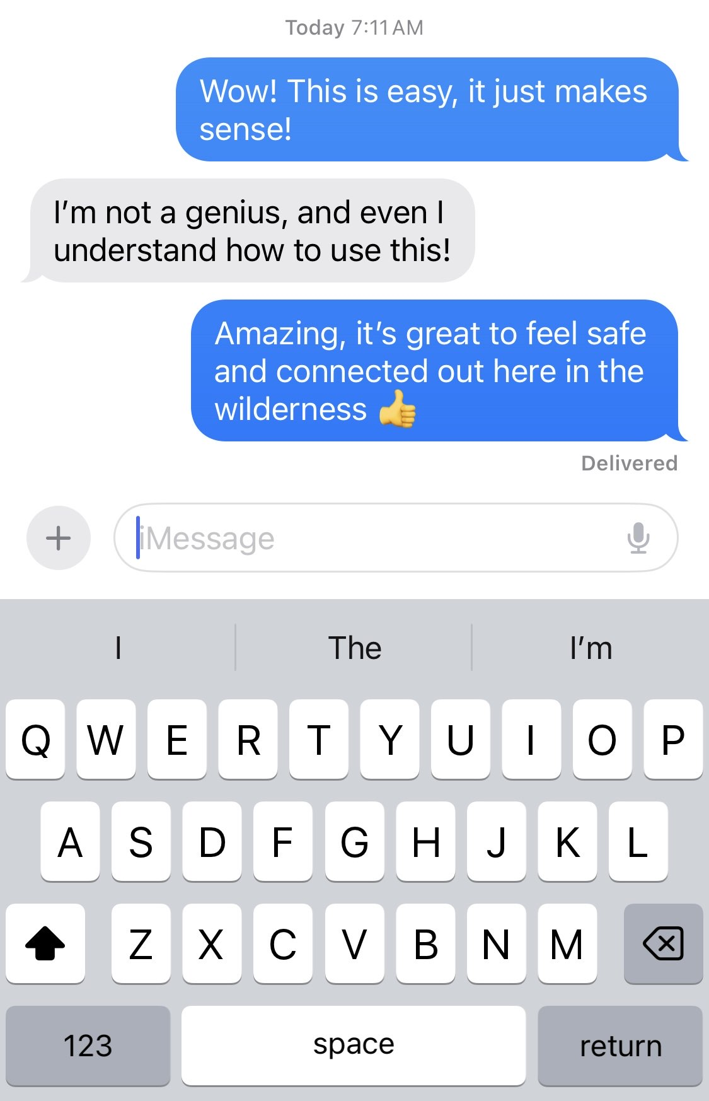

How will it work?
Notes:
How will it work: The user will connect to our wifi network hosted by a node. They will scan a QR code, launching the AVAlink webapp. No configuration, no need to make an account, just a simple messenger allowing users to communicate with other nodes or send an SOS alert in the event of an emergency. This design achieves our goal for everyone to intuitively understand how to use our platform without it having unnecessary feature bloat.

Slide 29


Robust Hardware
ESP32-S3
SX1262 LoRa Transceiver
SD
AVAlink web app
Petal Radio node
Notes:
Hardware
The petal nodes will be built using robust and efficient hardware. The local wifinetwork will be hosted by an esp32 s3 module which doubles as our microprocessor. WE chose this because it is wifi capable, has plenty of gpios, and its dual core architecture gives us plenty of processing capability for a low financial and power pricetag. An SD card will hold the web application files and chat logs, while The digital radio side will be handled by a Semtech LoRa transceiver which is the standard of choice for LoRa and IoT devices. We’ve also designed a low cost, high efficiency power supply that accommodates a wide range of battery and solar configurations.

Slide 30


User-friendly Software
Users Smart Phone
Local Server
ESP32
LoRa Transceiver
Wifi
HTTP Requests
SPI Bus
Notes:
Software/Firmware
This is a high level diagram of the Software and Firmware architecture we will be using. We are going to use the Blazor platform to develop a Web application because it can be served by the microprocessor as a web assembly file. This will offload the computing power to the user’s smartphone instead of the microprocessor. We have chosen to use the RUST programming language for our embedded development because of its memory safety, easy to use tooling and high performance.
Rust logo - https://rustacean.net

Slide 31
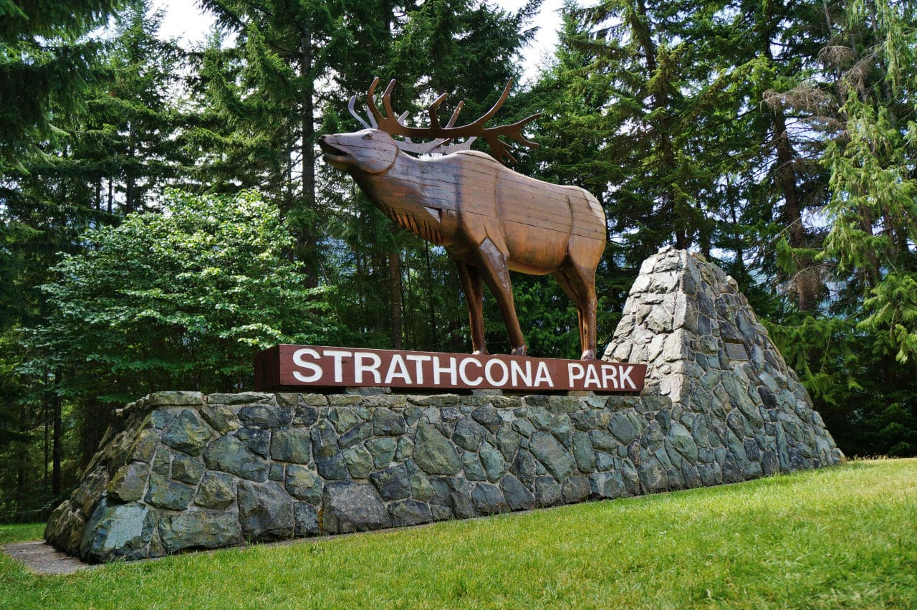
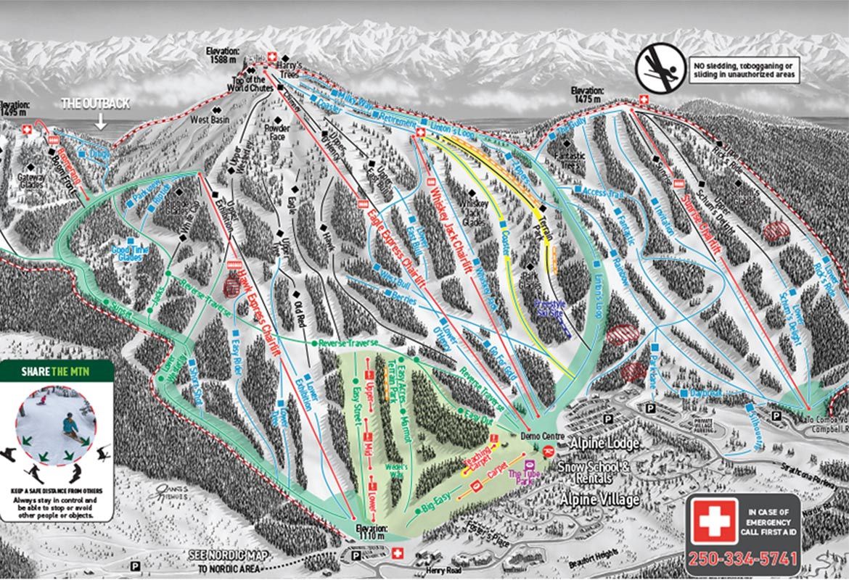
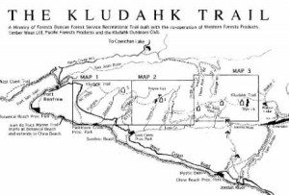
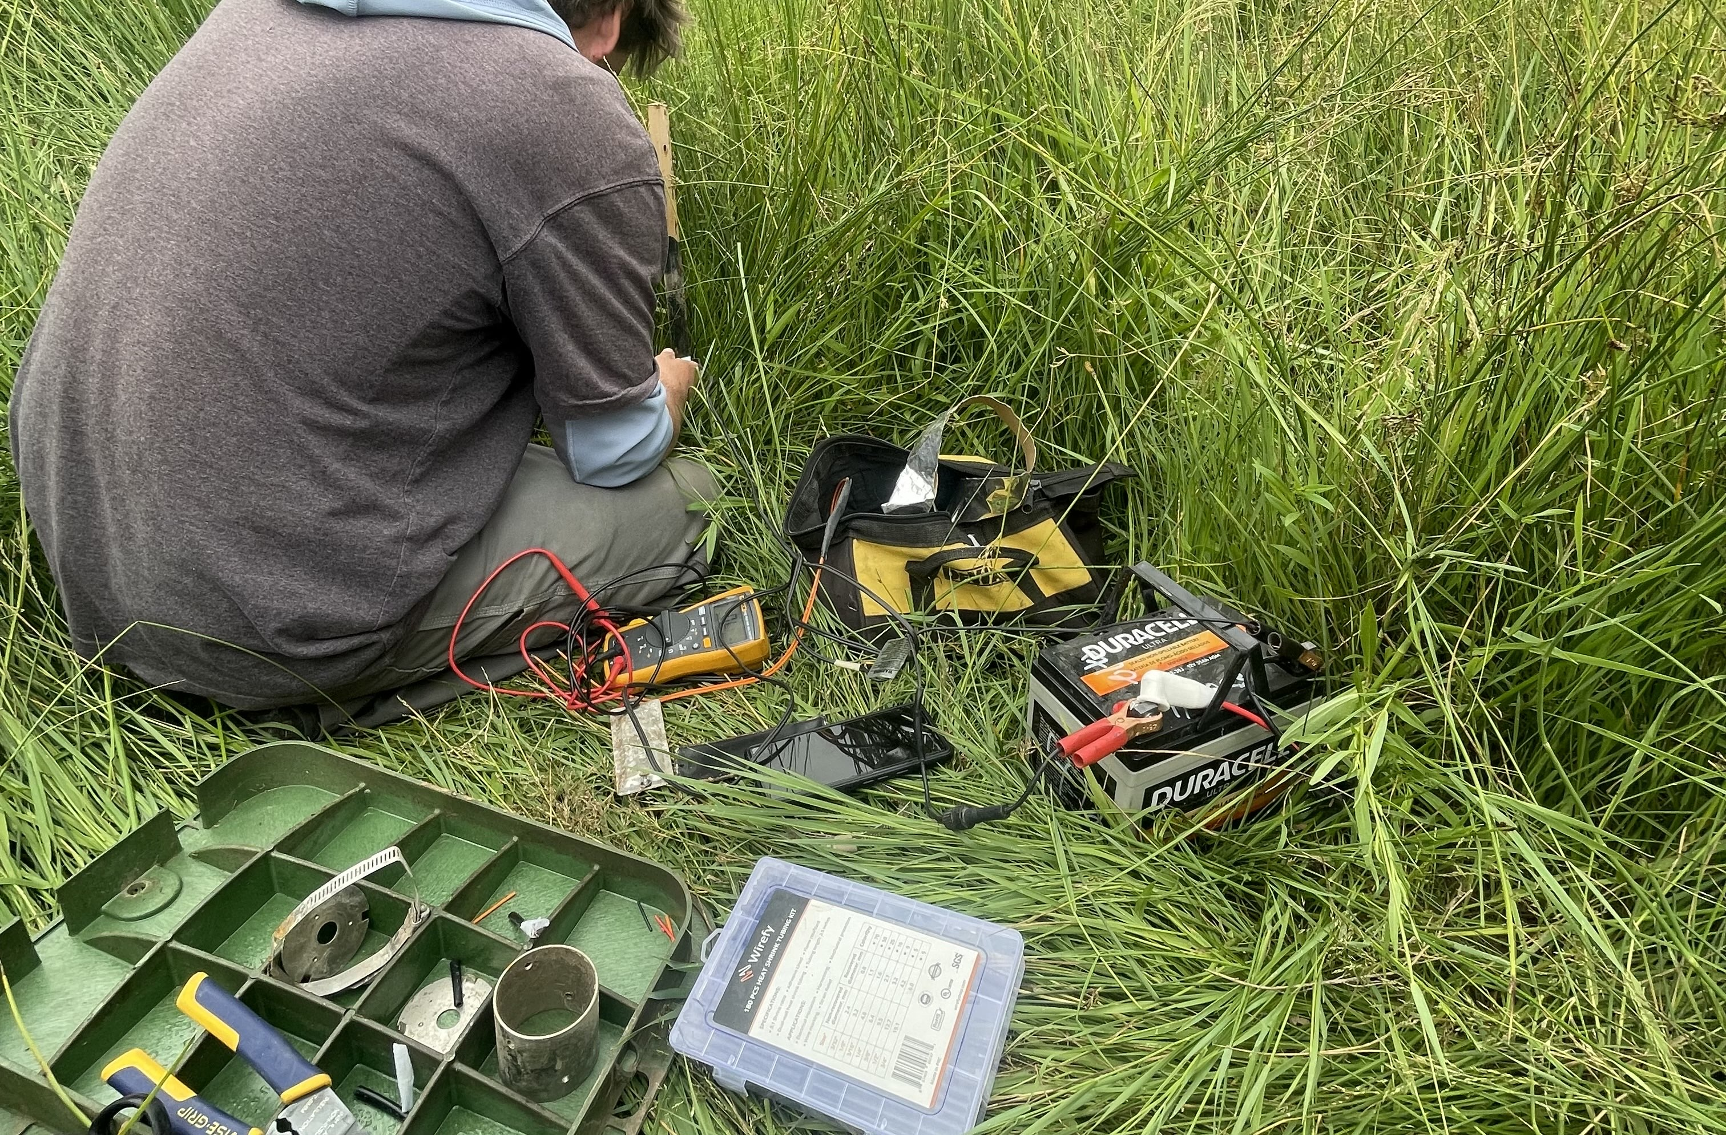
Provincial And National Parks
Ski Resorts
High Traffic Trails
Field Work
Notes:
Target Market
We aim to target established organizations that oversee remote areas and see a large volume of casual visitors. Our design can be implemented in Provincial or National Parks, high traffic hiking trails, field work operations, or recreation areas outside cellular service.

Slide 32
How would you spend your money?
$700
$700
Notes:
FINANCIALS
Now imagine for a moment that you run a nature tourism outfit.
- safe, accessible without compromising the experience
- cell phones are a no go
For $700 you could purchase a single in reach with 5 months of service
- Covers only a single person
Or, based on our budget
You could produce 9 nodes
Anyone can use it
Large coverage area.
Lower operating costs
Lower latency
We expect prototype to cost around $50/unit, but we hope to shave that down to around $30 once in production
- no more specialty modules
Depending on solar and battery requirements,

Slide 33
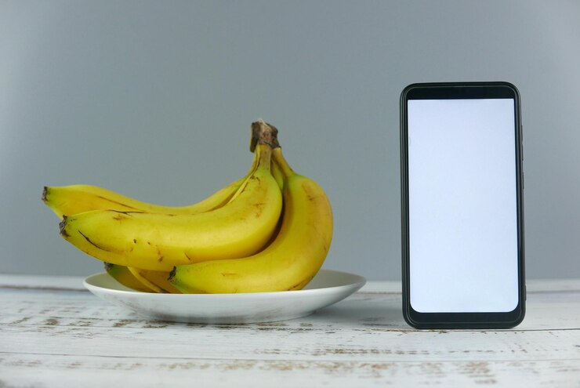
Leveling the playing field
Notes:
Is It OK To Hike In Jeans? (>800 Hikers Weigh In!) - Chasing Summits

